Slide 1
THE ARM7TDMI
Introduction And Architecture

Slide 2
INTRODUCTION TO ARM

Slide 3
Origin Of Name ARM7TDMI
ARM- Acron RISC Machine(Now Advanced Risc Machine)
T- The Thumb 16 bit instruction set.
D- On chip Debug support.
E- Enhanced Multiplier.
I-Embedded ICE hardware to give break point and watch point support.

Slide 4
ARM Features
RISC
32 bit processor
High performance, low power consumption and small in size
Large Register file
Load/store architecture
Pipelining
3- address instruction
Most of instruction get executed in single clock cycle.

Slide 5
THUMB architecture-(dense 16-bit compressd instruction set)

Slide 6
THUMB Instruction set (T variant)
Half of size of ARM instruction.
Greater code density
On execution 16 bit thumb transparently decompressed to full 32 bit ARM without loss of performance.
Has all the advantage of 32 bit core.
40% more instruction than ARM code.

Slide 7
With 32 bit memory
ARM code 40% faster than THUMB code
with 16 bit memory
Thumb code 45% faster than ARM code.
For best performance
use 32 bit memory and ARM code
for best cost and power efficiency
Use 16 bit memory and thumb code

Slide 8
In typical embedded system
-Use ARM code in 32 bit in chip memory for small speed-critical routines.
-Use Thumb code in 16 bit off chip me-mory for large non critical routines.

Slide 9
ARM state
All Instruction are 32 bit in length.
All instructions must be word aligned
PC value stored in bits [31:2] and bits [0:1] equal to zero

Slide 10
THUMB state
Instructions 16 bit in length
Instruction half-word aligned
PC value store in bits[31:1] and bit[0] equal to zero

Slide 11
Introduction to RISC and CISC
What is CISC?
-Complex instruction set computers
-These instruction perform complex
sequence of operation over many
cycles.
-large and powerful range of instruction
-less flexible to implement

Slide 12
RISC
Less number of instruction.
All instruction have same format and length
Memory access instruction are separated from instruction that process data i.e load and store architecture
A large resister bank of 32 register each of size of 32 bit
Pipelined instruction execution.

Slide 13
Advantage Of RISC
Reduction in the size of processor
High instruction throughput.
Excellent response for interrupt
Efficient use of CPU time.
Hardware cost is low.

Slide 14
Pipelines
Usually instruction are executed in three stage
-fetch
-Decode
-execute
Clearly, the portion of hardware which does fetching job will be idle during decode and execute phase.
The technique by which processor may perform many task at the same time is called Pipelining.

Slide 15
Pipe lining
Fetch
3rd instruction fetch
Decode
2nd instruction decode
Execute
1st instruction execute

Slide 16
Pipeline Stages
Fetch
-instruction code is fetched from ROM
Decode
-instruction is decode i.e what to do
or
-Control signal for next cycle is prepared
Execute
-For load and store instruction -value is load and store.
-For arithmetic operation –ALU operation perform

Slide 17
PROCESSOR MODE
ARM has 7 operating mode
•Switching between modes can be done manually through modifying the mode bits in the CPSR register.

Slide 18
-User
(unprivileged mode under which most task run)
-fast interrupt request mode FIQ
(to handle high priority interrupt)-interrupt mode
-IRQ
(to handle low priority interrupt)
-supervisor mode SVC
(entered on reset or a software interrupt)

Slide 19
-Abort mode ABT
(use to handle memory access violation)
-Undefined mode UND
(used to handle undefined instruction)
-System mode
(uses same register as user mode added at version 4)
The system mode is special mode for accessing protected resources. It don‘t use registers used by exception handlers, so it can‘t be corrupted by any exception handler error!!!
Privileged mode for OS Tasks

Slide 20
MODES
Most application program run in user mode
A program in user mode is unable to access some protected system resources or to change mode, other than by causing exception
Mode change can be by
-software control
-External interrupts
-Exception processing

Slide 21
MODES
Modes other than user mode are called privileged modes.
Privileged modes have full access to system resources
Five of them is called exception mode
-FIQ
-IRQ
-SRV
-ABT
-UND

Slide 22
MODES
Processor enters into Privileged modes under specific exception condition
All the exception modes uses some additional registers , to avoid corrupting the user state when exception occurs
SYS uses the same no: of register as the User Mode

Slide 23
REGISTERS
ARM has 37 32 bit long registers
30 general purpose registers
5 dedicated saved program status registers
1 dedicated current program status register
1 dedicated program counter.

Slide 24
General Purpose Registers
30 32 bit registers
15 general purpose registers are visible at one time, depending on the current processor mode, as r0,r1,r2…..r13,r14
r13 conventionally used as stack pointer
r14 conventionally used as link register to store the return address for exception/ sub-routine call

Slide 25
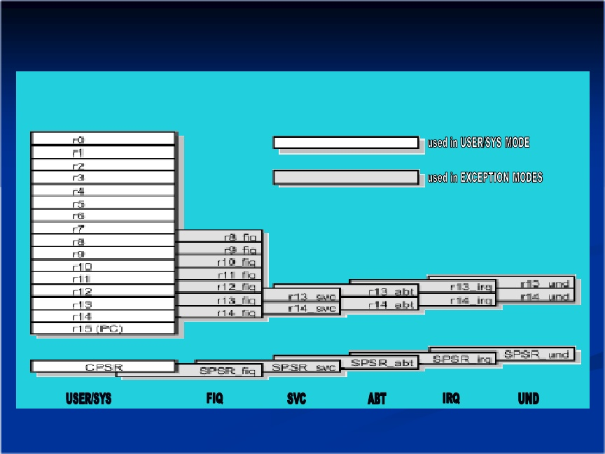
30 General Purpose Registers

Slide 26
Program counter
PC is accessed as r15.
Increment by 4 byte for ARM state and 2 byte for THUMB state.
Due to pipelining address of current executing instruction is PC-8 in ARM state and PC-4 in THUMB state.
PC is 32 bit, for ARM state bits 1&0 are always zero or ignored
For thumb state bit 0 is always zero or ignored.

Slide 27
Rather than pointing to the instruction being executed, the PC points to the instruction being fetched.

Slide 28
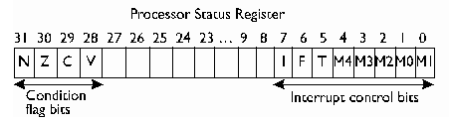
CPCR- Current program status register
CPCR holds
-copies of ALU status flag
-The current processor mode
-Interrupt disable flag

Slide 29
FLAGS
Condition code flags
N(31) result of instruction
N=0 if positive
N=1 if negative
Z(30) Z=1 if result is zero
Z=1 if not zero
C(29) for addition set to 1 if carry occurs & 0 otherwise
for subtraction, set to 0 if borrow occurs & 1 otherwise
V(28) for addition and subtraction V set to 1 if signed overflow occurs

Slide 30
FLAGS
Control bits
I(7) when set disable IRQ interrupt
F(6) when set disable FIQ interrupt
T(5) on T variants of v5
T=0, indicates ARM execution
T=1, indicates THUMB execution
on non-variants
T=0, indicates ARM execution
T=1, causes the next instruction . executed to cause UND

Slide 31
FLAGS
MODES BITS (4:0)
M(4:0) | MODS
10000 | User
10001 | FIQ
10010 | IRQ
10011 | Supervisor
10111 | Abort
11011 | UND
11111 | SYS

Slide 32
SPSR-Saved Program Status Register
Use to store CPSR when an exception is taken
One SPSR is accessible in each of exception handling mode
User mode and System mode does not have SPSR as they don’t handle exceptoion

Slide 33
General Purpose Registers
Can be divided into three groups
Un-banked
banked
PC r15

Slide 34
Un-Banked Register
Register r0-r7.
Each of register have same physical register for all the modes
Completely general purpose register, with no uses implied by the architecture

Slide 35
Banked Register
Register r8 to r15
Physical register referred to by each of them depends on the mode of operation
Banked register contents are preserved across operating modes changes

Slide 36
Banked Register
r8 to r12
-Two banked physical registers
-One for FIQ and other for all other modes
-Referred to as r8_usr to r12_usr & r8_fiq to r12_fiq
r13&r14
-Has six USER & SYS and rest five in each exception mode

Slide 37
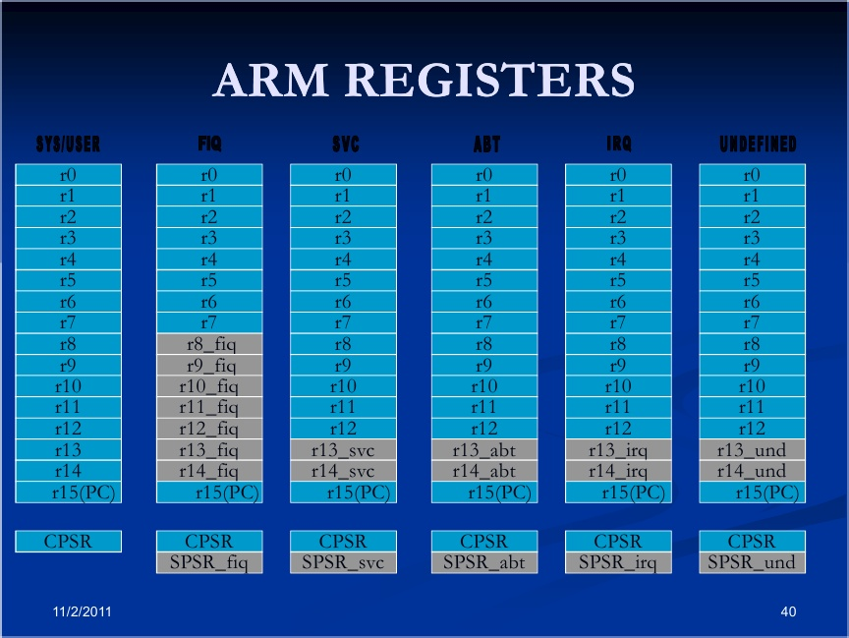

Slide 38
Thumb State Register Set
It’s a subset of ARM state
The programmer has access to
-8 general register r0 to r7
-PC
-SP
-LR
-CPSR
-SPSR(for exception only)

Slide 39
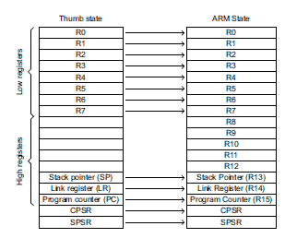
Mapping of THUMB state register to ARM state register

Slide 40
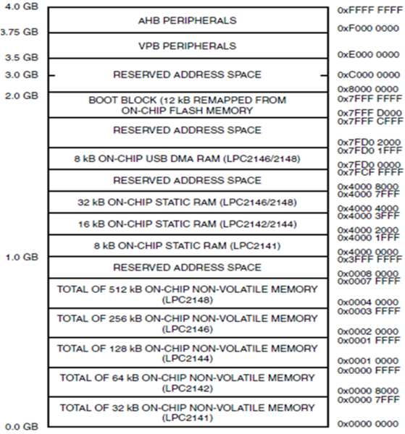
Memory mapping
RAM addressing space
ROM addressing space

Slide 41
ARM7 MCU Bus structure
There are two types of Busses in ARM7
1)Advanced HIGH PERFORMANCE BUS (AHB)
2) VPB bus
Processor Clock
(cclk)
Crystal Oscillator or
External Clock Source
(Fosc)
PLL
VPB divider
VPB Clock
(pclk)

Slide 42
AHB
AHB is fast bus which is clocked directly by PLL
its works at same speed as ARM core.
So ARM core and Interrupt controller are directly connected with AHB
VPB
while other peripherals are connected through VPB divider.
VPB divider is capable to divide speed of AHB by 1; 2 and 4.
this means if VPB bus divider will be set to 4 and CPI core speed will be 60MHz, then MCU timer will run at speed 60/4=15MHz.

Slide 43
Dual power supply:
CPU operating voltage range of 1.65 V to 1.95 V (1.8 V ±0.15 V).
I/O power supply range of 3.0 V to 3.6 V (3.3 V ± 10 %) with 5 V tolerant I/O
pads.

Slide 44
C
Programming

Slide 45
GPIO

Slide 46
PORT 0
Port 0 is 32 bit bidirectional I/O ports with individual direction control for each bit.
PIN 26 and 31 of port 0 is not available.
PORT 0 required external pull down register.

Slide 47
PORT 1
Port 0 is 32 bit bidirectional I/O ports with individual direction control for each bit.
PIN 16 of port 1 is not available.

Slide 48
Pin Function Select register 32 bit
PINSEL0
PINSEL1
PINSEL2
In ARM 7 every pin have multiple function.
PINSEL registers is used to select function of each PIN.

Slide 49
Register description
IOPIN
Set to read PIN
IOSET
Set to set corresponding PIN
IODIR
To control direction of PIN
0 for i/p
1 for o/p
IOCLR
Set to clear PIN

Slide 50
PORT0 Blinking
Header file
#include <LPC21xx.H>
void main()
{
unsigned int i;
PINSEL0=0x00000000;
PINSEL1=0x00000000;
IODIR0=0xffffffff;
while(1)
{
IOSET0=0xffffffff;
for(i=0;i<50000;i++);
IOCLR0=0xffffffff;
for(i=0;i<50000;i++);
}
}
To select function of PORT0 as GPIO
To set direction
To set
To clear

